Slide 1

VISHNUVASAN M
FINAL PROJECT
NM ID: 65EDC56F0B4B0DA8E3745FB005154D46
MADRAS INSTITUTE OF TECHNOLOGY CAMPUS, ANNA UNIVERSITY

Slide 2
WASTE SEGREGATION
USING CONVOLUTION NEURAL NETWORK(CNN)
Marking segregation made easier!!

Slide 3


AGENDA
Develop and integrate a facial recognition system using CNN to accurately identify individuals from a database of facial images.
Implement a system to log attendance based on facial recognition results and add the attendance to a csv file with timeframe.

Slide 4

PROBLEM STATEMENT
Efficient Waste Sorting : Develop a CNN model to accurately classify waste items into recyclable and organic categories, reducing sorting time and human error.
Create a scalable waste segregation system to promote sustainable practices and minimize landfill waste, contributing to a cleaner environment.
Automation for Sustainability: Implement machine learning algorithms for automated waste sorting, enabling cost-effective and eco-friendly waste management solutions.

Slide 5

PROJECT OVERVIEW
STEP 1
STEP 2
STEP 3
STEP 4
DATA COLLECTION
DATA PREPROCESSING
MODEL BUILDING
MODEL EVALUATION
Collect a large dataset of images containing different types of waste materials, categorized into recyclable and organic waste.
Preprocess the images by resizing them to a standard size and normalizing the pixel values..
Define a CNN architecture with convolutional layers, pooling layers, and fully connected layers. Train the CNN model on your labeled dataset.
Evaluate the performance of your model on a separate test dataset. Calculate metrics like accuracy, precision, and recall to assess how well the model classifies waste items.

Slide 6

Solution
Waste Segregation using Convolution Neural Network(CNN)
Train a CNN on images of recyclable & organic waste. Deploy the model to classify waste items in real-time.
Reduce contamination in recycling streams. Increase the amount of material recovered for reuse.
Individuals get feedback on sorting correctly. Waste management saves costs through efficient sorting.
Real-time Processing and Segregation
Capture waste images through camera or smartphone app. CNN analyzes the image instantly for recyclable or organic.
System provides real-time feedback on waste type. Users receive clear instructions for proper disposal.

Slide 7

Accuracy and Reliability
Value Proposition
Ensure accurate attendance tracking through advanced facial recognition technology, minimizing errors associated with manual methods.
Provide a reliable solution for monitoring attendance in various environments, including classrooms, offices, and events.
Efficiency and Time Savings
Streamline the attendance tracking process, saving time for both administrators and users.
Reduce administrative workload by automating attendance logging and management tasks.
Enhanced Security
Implement robust security measures to protect facial data and prevent unauthorized access or misuse.
Ensure compliance with privacy regulations, safeguarding the privacy of individuals' facial information.
Scalability and Adaptability
Design the system to be scalable, accommodating varying numbers of users and adaptable to different environments.
Integrate with existing systems and databases, providing flexibility and compatibility with organizational requirements.

Slide 8


WOW FACTOR
Real-Time Accuracy
01
With facial recognition technology powered by CNN, the system can accurately identify individuals in real-time, eliminating the need for manual input and reducing errors to an unprecedented level.
Effortless Efficiency
Transforming waste segregation with CNN-powered image recognition, where accuracy meets innovation.
02
Imagine walking into a classroom or office space and being automatically logged in within seconds, without any effort on your part. That's the power of this automated attendance system
03
Cutting-Edge Innovation
It's not just about automating attendance – it's about pushing the boundaries of what's possible with facial recognition technology.
Vishnuvasan

Slide 9
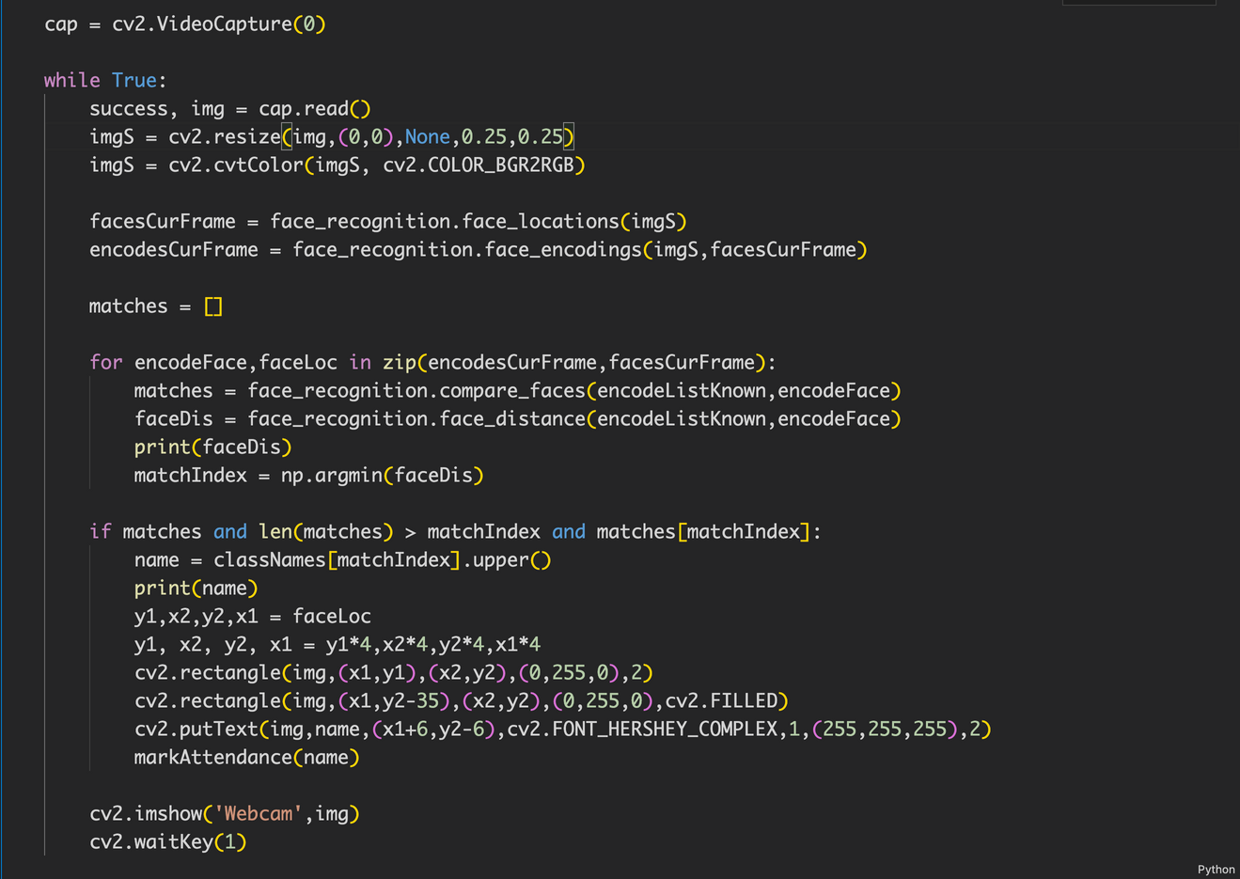
MODELLING
CAPTURING THE IMAGE USING CV2 MODULE AND BUILDING THE NEURAL NETWORK USING FACE_RECOGNITION MODULE:

Slide 10
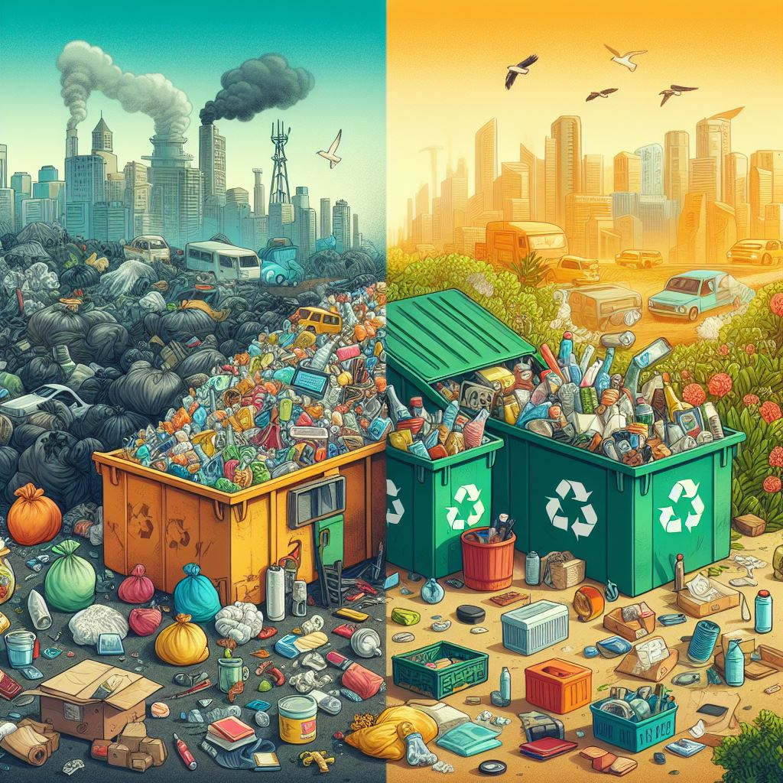
RESULT
DEMOLINK:
https://github.com/VISHNUVASANM/NM_GEN_AI

Slide 11

Expressing my gratitude to the audience for their time and participation.

